Slide 1
SECURE DATA HIDING IN IMAGES USING STEGANOGRAPHY
CAPSTONE PROJECT
Presented By : Anushka Rohilla
Student Name : Anushka Rohilla
College Name : Glocal University Department : Computer Science and Engineering

Slide 2
OUTLINE
Problem Statement
Technology used
Wow factor
End users
Result
Conclusion
Git-hub Link
Future scope

Slide 3
Problem Statement
With the rise in digital communication, ensuring data security has become crucial. Traditional encryption methods often attract attention, making them susceptible to interception. Steganography offers an alternative by concealing data within images, making the hidden content undetectable. This project focuses on developing an efficient technique to embed one image within another without significant distortion. The Least Significant Bit (LSB) method is used to maintain image quality while securing the hidden data. The goal is to create a user-friendly tool that enables secure image-based data transmission. Future improvements will enhance security and adaptability for various use cases.

Slide 4
Technology used
Python - For simplicity, powerful libraries and strong cybersecurity capabilities.
IDLE (Python’s Default IDE) - Basic, lightweight, suitable for testing.
OpenCV (pip install opencv-python) - For advanced image and video steganography.
Stegano - Python library for hiding messages in images.
Github - Version control and collaboration for security projects.

Slide 5
Wow factors
Implement multi-layer steganography, hiding both text & files inside an image.
Allow users to upload, encrypt, and retrieve hidden data remotely.
Implement multi-user authentication for secure access to stored files.
Prevents cybercriminals or third parties from intercepting sensitive data.
Instead of just hiding text in images, allow real-time webcam steganography using OpenCV.

Slide 6
End users
Government & Intelligence Agencies - For secure communication and covert data transfer.
Cybersecurity Professionals - To ensure encrypted data exchange in high-risk environments
Businesses & Corporations - For protecting confidential documents and trade secrets.
General Users - Individuals who need personal data protection and privacy in digital communication.
Researchers - To safeguard research data, particularly when collaborating with international teams or sharing data remotely.
Cryptographers - For developing and testing advanced encryption and data hiding techniques.

Slide 7
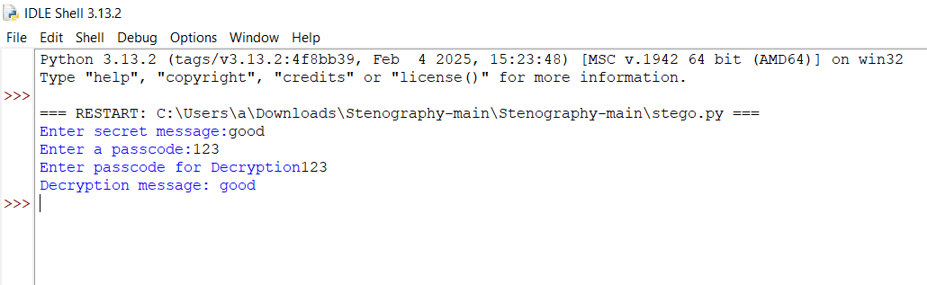
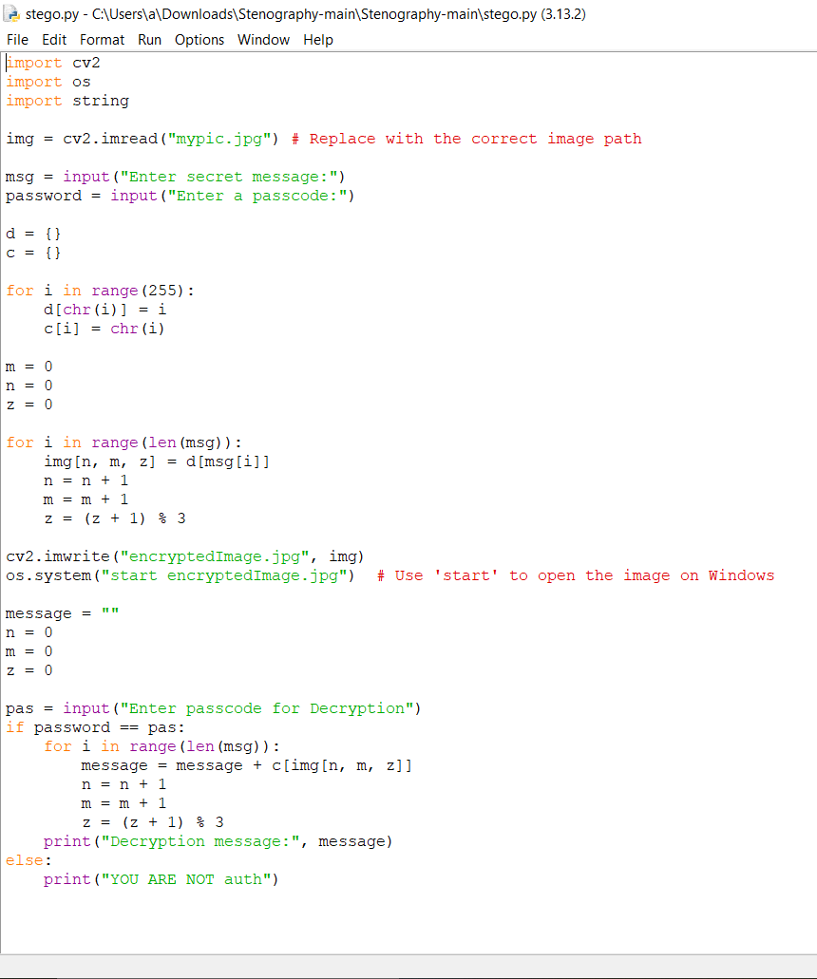
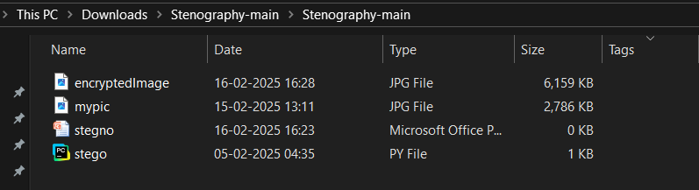
Results

Slide 8
Conclusion
In conclusion, the Secure Data Hiding in Images using Steganography project addresses the critical need for secure communication of sensitive information. By embedding data within images, the project ensures that information remains hidden from unauthorized access. The use of encryption and image processing techniques guarantees confidentiality and data integrity. This method provides a reliable solution for individuals, businesses, and organizations to securely exchange private data. The project showcases the potential of steganography in enhancing digital security. It highlights the effectiveness of combining image and cryptographic techniques to protect information. Future improvements could focus on increasing embedding capacity and robustness. Overall, the project reinforces the importance of secure communication in the digital age.

Slide 9
GitHub Link
https://github.com/Anushka-Rohilla/Aicte_project.git

Slide 10
Future scope(optional)
Real-Time Data Hiding: Enabling real-time data hiding for instant and secure communication, especially for applications in live streaming or video conferencing.
Multi-Layered Encryption: Integrating multiple layers of encryption techniques for enhanced security, making it harder for attackers to decode hidden data.
Cross-Platform Compatibility: Extending the system to work across various platforms and devices, ensuring secure data hiding capabilities on mobile phones, IoT devices, and cloud storage systems.
Automated Detection: Creating automated tools to detect and recover hidden data, which could be useful in forensic and security applications.

Slide 11
THANK YOU

